Slide 1
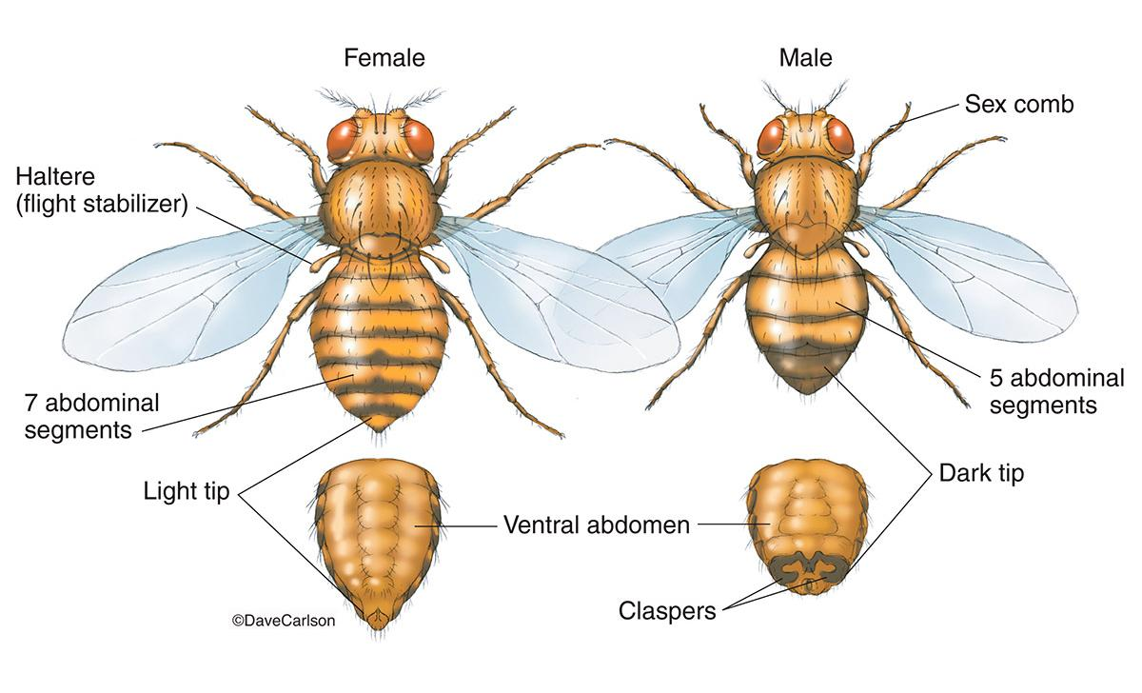
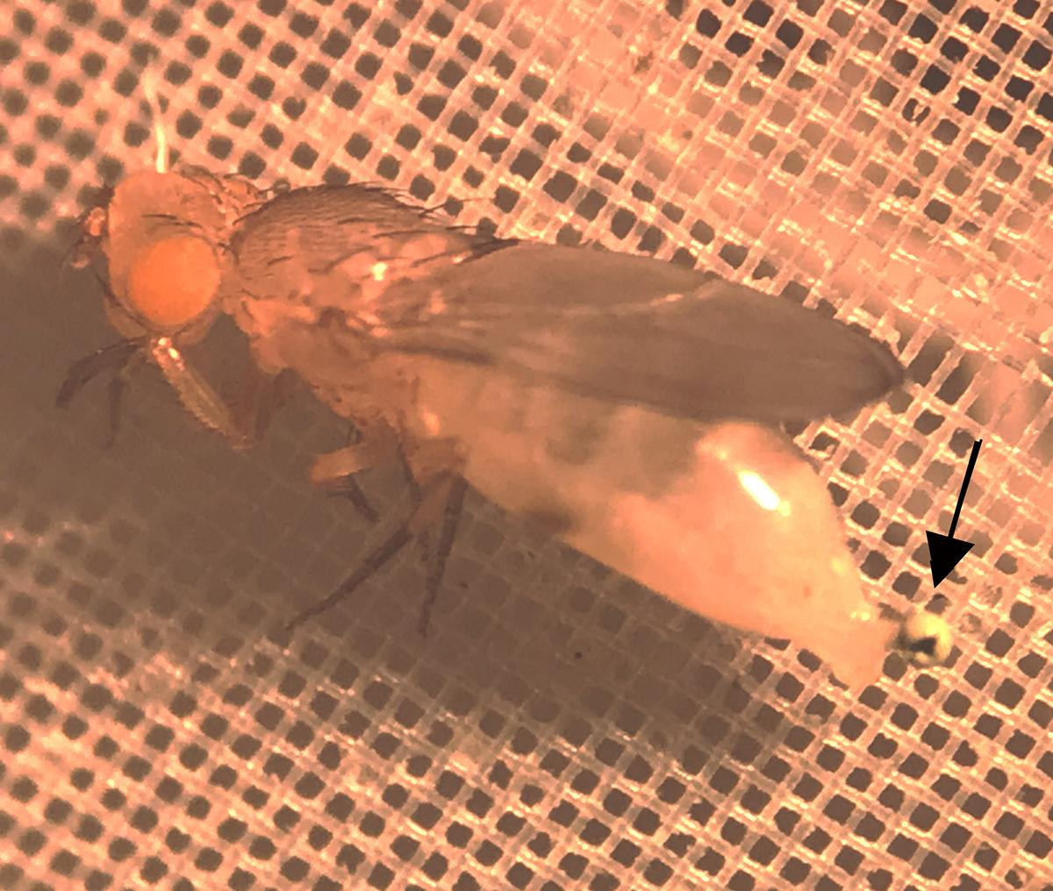
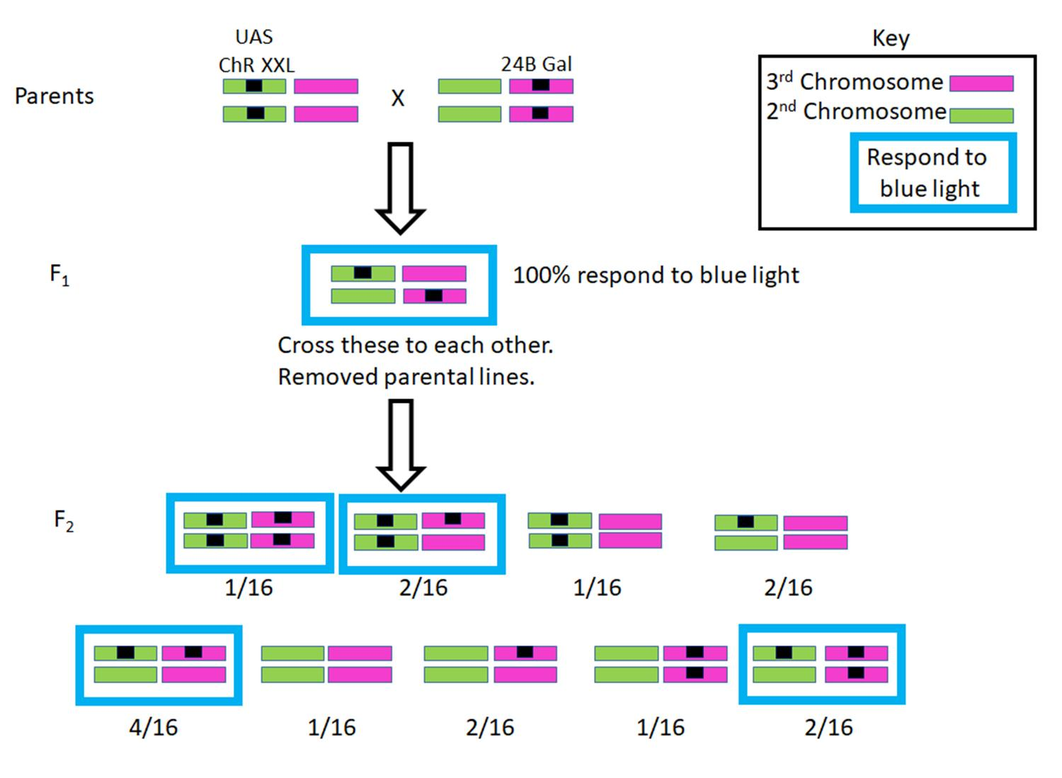
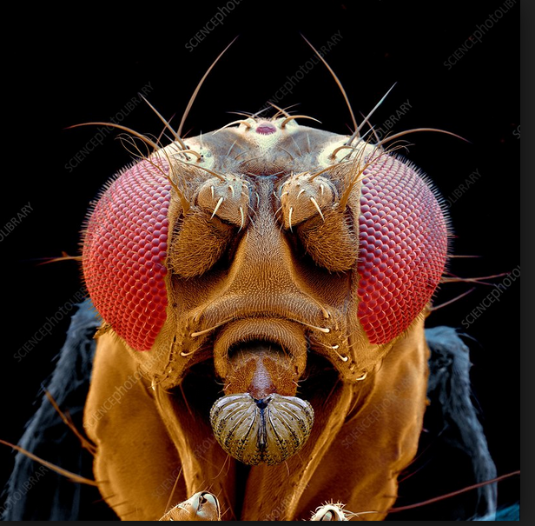
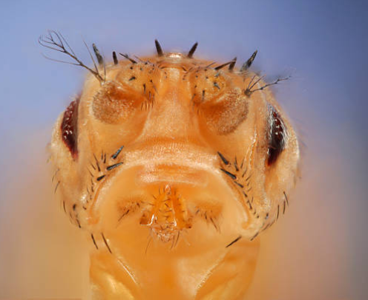
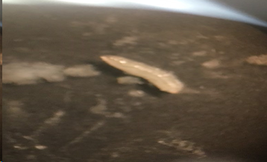
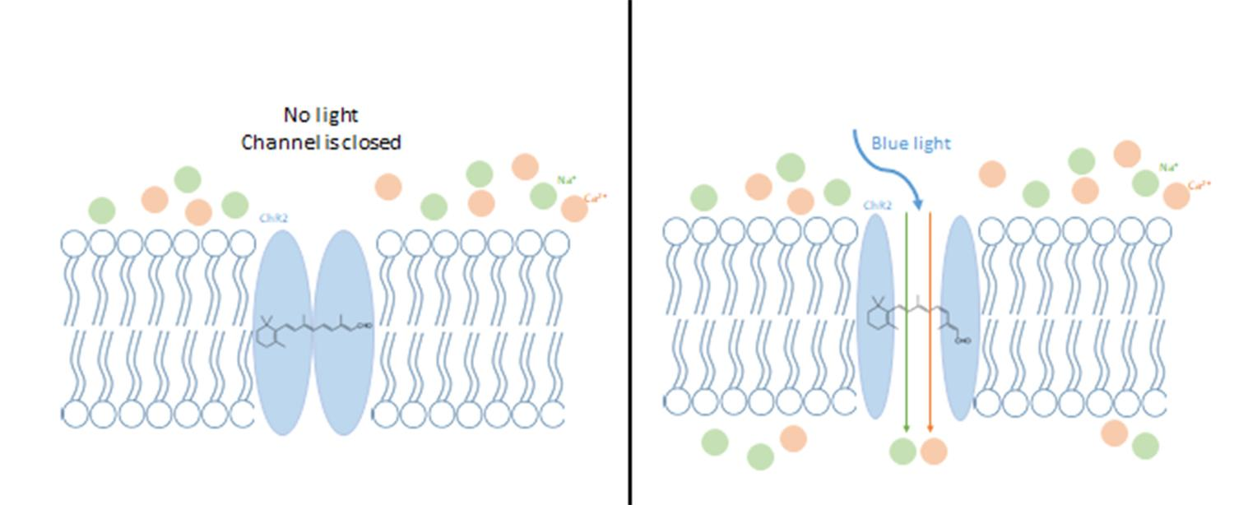
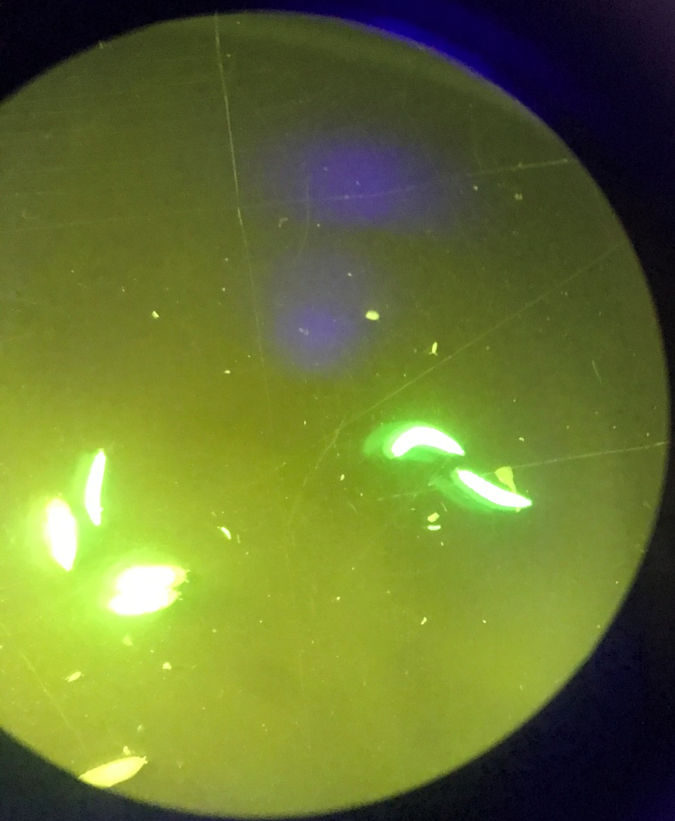
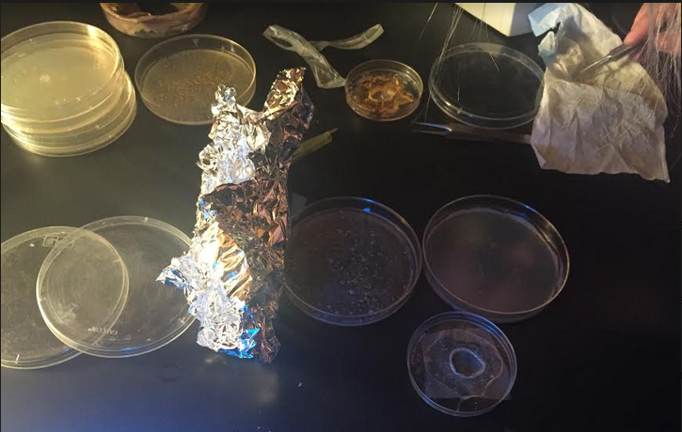
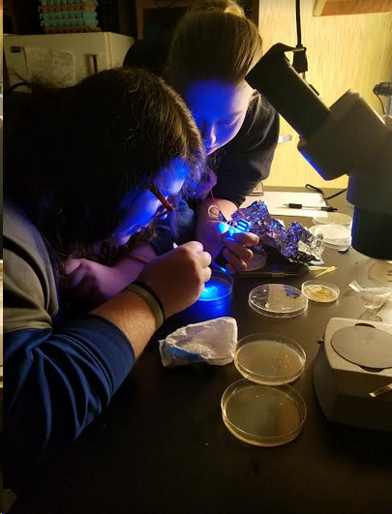
Revisiting Mendel: Use of a behavioral assay to examine inheritance of traits in Drosophila
Jeffrey M. Chalfant², Robin Cooper¹, Tawny Aguayo-Williams², Lexie Holtzclaw³, Madison Loveless³, Jennifer Wilson³, and Doug Harrison¹
¹Department of Biology, University of Kentucky, Lexington, KY, ²Department of STEM Education, University of Kentucky, Lexington, KY, ³Pulaski County High School, Somerset, KY
Abstract
Methods
Results
Learning Objectives
Using the established rules of Mendel and others, predicting the outcome of genetic crosses in model organisms is a common exercise for college students. Frequently one uses visible phenotypic markers such as curly wings, eye color, and abnormal bristles. Yet many genetically-based traits, such as behavioral and physiological characteristics, are not observed as simply. To demonstrate that such traits can likewise display classical genetic inheritance, we utilized an optogenetic system in Drosophila to modify response to light. We utilized the inheritance of behavioral responses associated with light-activated channelrhodopsin in motor neurons and body wall muscles. The frequency of responsive animals was quantified over multiple generations beginning with two pure-breeding (homozygous) strains, each containing one of the two components needed to produce the light-sensitive proteins. The use of light-sensitive channels to examine the predicted genetic outcomes is an approach which can be used in teaching classical genetic principles using non-traditional phenotypes. Green fluorescent protein can be expressed to illustrate which cells are expressing channel rhodopsin. This introduces concepts of transgenesis, genetically-modified organisms, and genetic contributions to behavior. In addition to basic dominant and recessive allelic relationships, the experiments can also introduce more complex genetic concepts, such as epistasis, gene expression and cellular diversity, as well as physiological and behavioral traits of animals. This module is presented in a variety of ways depending on equipment available and can be used in a hybrid or remote format with data provided.
B
C
I
This is a nice extension of an earlier exercise which just encompassed the aspect of optogenetics but did not address Mendelian genetics or an assay to examine the genetic expectations.
Students apply optogenetics to the study of locomotion and potentially other behaviors in Drosophila larvae.
Students observe firsthand how optogenetics can be used to activate muscle in a live, genetically modified organism.
Students practice observational skills and work as a team to obtain measurements of behavior.
Students make predictions in the genetic outcomes and then test their predictions.
Students discuss the many variables which may affect the outcome of the results and learn about ways to control for some of them.
Students input data into spreadsheets and use software to analyze and graph the data.
Students collaborate within a group to explain important aspects of the experiments to their peers.
The participants for this exercise will be able to construct models in the expected genetic linage to explain the observed outcome. The direct real-life examples with how optogenetic or activation of light sensitive channels may have a role in medicine and health. The ability to manipulate various physiological systems and stimulation paradigms promotes experimental design and redesign based on the observed findings from each experiment.
The pre-recorded movies online and can be used to simulate the exercise with remote learning. The students can then observe the larval responses just as they would in a classroom and determine which larvae were responsive to the light. Also, responses are pre-recorded for larvae fed ATR and for larvae not fed ATR so the effect of adding the channel rhodopsin modifier can be discussed.
https://www.carlsonstockart.com/photo/fruit-fly-drosophila-male-female-illustration/
Figure 2: Females are determined as they do not have as many black hairs on their ventral part of the abdomen and they do not have black hairs on their 1st pair of legs (B). Virgin females are determined by freshly eclosed flies from pupa which have a green fecal matter (meconium) being expelled (C).
D
E
Figure 6: The expectations in the percent that would respond to blue light for the F1 and F2 generations (I).
J
Figure 7: A responsive larvae shows a marked contraction with blue light, unlike the relaxed larvae pictured here. The percentage of larvae which showed contraction in F1 and F2 generations can be made into a table or graphed in various ways for students to present.
Introduction
Figure 3: Non-stubble (hairs longer and thinner than stubble) (D). Mutation Stubble (hairs shorter and thicker than wild-type) (E). https://www.sciencephoto.com/media/369771/view/drosophila-fly-head-sem
Optogenetics is a powerful and relatively new tool used in a variety of fields, particularly those dealing with excitable cells such as neurons. The process involves transfecting an organism with a protein which are light sensitive. There are several types. The channelrhodopsin is a cation channel which depolarizes cells. Channelrhodopsin (CHR-XXL) requires a cofactor called all-trans retinol (ATR) which is not naturally produced by many organisms; thus, ATR must be ingested as a food supplement. The model organism Drosophila melanogaster was used for many studies involving these light sensitive proteins expressed in various cell types.
In order to have the proteins expressed usually a genetic cross is involved when using Drosophila. One has to be careful in crossing the fly lines. In some cases, the generation may mix and this can be a problem for obtaining the appropriate expression in the correct cells and responses.
As many high schools and colleges use Drosophila for teaching genetics, we developed this project to highlight two aspects which could be used as educational projects. One part of the project is to understand the genetic crosses for the F1 and F2 outcomes. The second is to understand the physiology and potential uses of optogenetics.
We used the behavioral responses in responses to stimulating the light activated channels to determine in the expected outcomes in the genetic crosses matched the theoretical expectations. The larval stages from a F1 and F2 generation were used.
To illustrate the cells being selectively used to express channel rhodopsin we use other lines expressing green fluorescent protein which can be seen with fluorescence microscopy.
Channelrhodopsin
K
L
F
M
Figure 4: When blue light shines on the channel the channel opens and allows Na⁺ and some Ca²⁺ to flow into the cell. In this case a muscle cell which results in the cell contracting (F). The blue light (470nm wavelength, LEDsupply, LXML-PB01-0040, 70 lm @ 700mA) was provided by a high intensity LEDs. The photon flux (number of photons per second per unit area) was measured with a LI-COR (model Li-1000 data Logger, LDL 3774) which produced around 103 uMol s-1 m-2 per uA on the surface of the larvae.
Figure 8: Larvae in a dish expressing GFP in body wall muscles (MHC GFP line, FBti0147557; Bloomington stock number 38462- y¹ w*; P{Mhc-GFP.F4-453}2) (K,L). Expression of GFP can also be observed in pupae instead of larvae. The muscle expression with the MHC- GFP (M).
G
H
Discussion
References
Methods
As an educational exercise in genetics using Drosophila as well as expressing a protein which is light sensitive that has potential for therapy in humans, this was an informative.
The Mendelian genetics is an important concept to learn by doing and to realize that one might not obtain the precise outcome due to other variables (i.e., damaging the larvae in moving them, survival of the larvae expressing a transgene, conducting the assay with a light stimulus).
The behavioral assay in using light to activate the channelrhodopsins was educational in learning about the cellular physiology and muscle contraction as well as the many variables which are possible to be addressed.
More sensitive channel rhodopsin lines can be used for the assays, such as UAS-ChR2.XXL line (BDSC stock # 58374).
Brand AH and Perrimon N. (1993) Targeted gene expression as a means of altering cell fates and generating dominant phenotypes. Development. 118(2):401-15.
Dawydow, A., et al.,, 2014. Channelrhodopsin-2-XXL, a powerful optogenetic tool for low-light applications. Proc. Natl. Acad. Sci. 111, 13972- 13977.
Deisseroth, K., 2014. Circuit dynamics of adaptive and maladaptive behaviour. Nature 505, 309-317.
Majeed, Z., Koch, F., Morgan, J., Anderson, H., Wilson, J., and Cooper, R.L. (2017) A novel educational module to teach neural circuits for college and high school students: NGSS-neurons, genetics, and selective stimulations. F1000Research. F1000Research: Immediate & Transparent Publishing for Life Scientists. F1000 Research Ltd, Middlesex House, 34-42 Cleveland St, London W1T 4LB, UK. https://f1000research.com/articles/6-117/v1
Pulver, S.R., Griffith, L.C., 2010. Spike integration and cellular memory in a rhythmic network from Na+/K+ pump current dynamics. Nat Neurosci. 13(1): 53–59. doi: 10.1038/nn.2444
Pulver, S.R., Pashkovski, S.L., Hornstein, N.J., Garrity, P.A., Griffith, L.C., 2009. Temporal dynamics of neuronal activation by Channelrhodopsin-2 and TRPA1 determine behavioral output in Drosophila larvae. J. Neurophysiol. 101(6), 3075-3088. doi: 10.1152/jn.00071.2009.
Riemensperger, T., Kittel, R.J., Fiala, A., 2016. Optogenetics in Drosophila neuroscience. Methods Mol. Biol. 1408, 167-175
Titlow JS, Anderson H & Cooper RL. 2014, Lights and larvae: Using optogenetics to teach recombinant DNA and neurobiology. The Science Teacher, National Science Teacher Association, NSTA. 81(6):3-9.
A
Testing the larvae for sensitivity to blue light
Figure 5: Larval behavior. Locomotion behavior was assessed by placing larvae on an apple-juice 1% agar plate. The larvae were left for one minute to acclimate (G). The body wall movements were noted when blue light was shined on them (H).
Acknowledgements
Figure 1: Fly lines. Virgin females of UAS-ChR2-XXL (BDSC stock # 58374) are crossed with with male, non-stubble 24B-Gal4 (III) (BDSC stock # 1767) (A).
This work was funded by American Physiological grant to the Kentucky chapter.

